Slide 1
Image Classification of 100 sports
Group: ML2_T2120
Notes:
Hello
I am Ayat Abdulaziz Gaber Al-Khulaqi,
For the assignment I picked to do image classification of 100 sports

Slide 2
Group Members
No. | Name | Id No | Specialization
1. | Ayat Abdulaziz Gabe r Al-Khulaqi | 1191202335 | Data Science

Slide 3
About The Dataset
Pre-processing Methods
Research methodology and Models
Initialization, Training, and Tuning of Hyperparameters
Performance evaluation, comparison, and discussion on the results
Conclusion and Future Enhancements
Notes:
So, this in presentation, I am going to discuss these 6 points
(mention the six points)

Slide 4
Introduction
Image classification of 100 different sports using a dataset from kaggle website. The image classification will be done using Convolutional Neural Network (CNN) and Transfer Learning.
Notes:
The 100 sports dataset was from Kaggle website, the image classification was done using Convolutional Neural Network CNN and transfer learning.
In transfer learning three architecture models was used, which are:
- MobileNetV2
- VGG19
- ResNet101V2

Slide 5
About The Dataset
About the directories
Number of images
Content
Notes:
The collection of sports images covering hundred different sports which contains 14,572 images in jpg format.
The data divide into three directories: train, test, and valid.
Images were converted to jpg format and resized to 224x224x3

Slide 6
Pre-processing Methods
Acquiring the dataset
Crucial Libraries Used
Import Dataset
Create tf.data.Dataset
Class Distribution
Displaying Images from the Datasets
Notes:
Under the pre-processing methods, I will be explaining (point out the 5 points),
As I mentioned before that 100 sports dataset is from Kaggle so that explains for the point

Slide 7
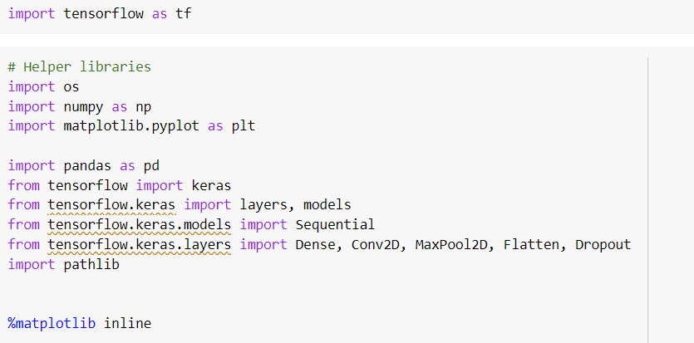
Crucial Libraries Used
Notes:
Here are the libraries were used in the coding, for the layers for CNN and transfer learning had different set up of layers.
Also to mention that in transfer learning I import other libraries for each architecture model.

Slide 8
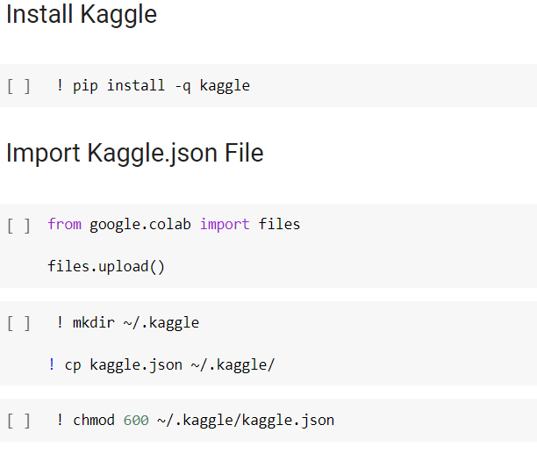
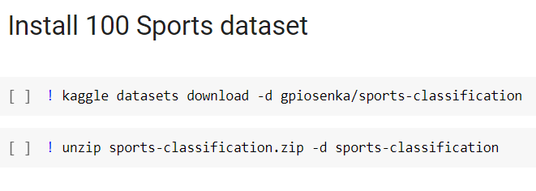
Import Dataset
1.
3.
2.
Notes:
So the first step was to install Kaggle to be able downloading the dataset.
Then from Kaggle website I generated the Kaggle.json file
Then uploaded to my google colab
Lastly was to download the dataset, to do that first I had to get the API from the Kaggle website then to download it
Then I unzip the sport classification folder

Slide 9
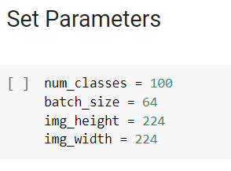
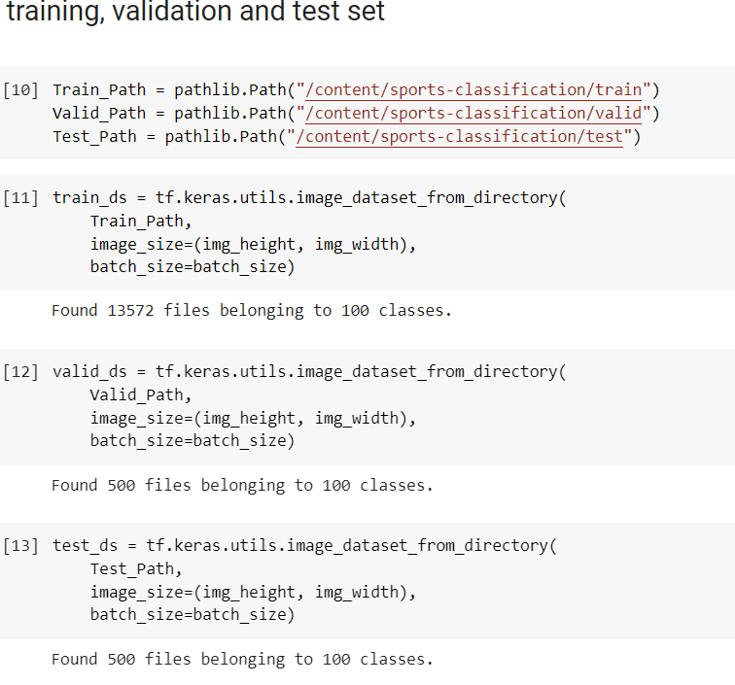
Create tf.data.Dataset
1.
2.
Notes:
The total number of class is set to be 100
Batch size is set to be 64
Image height and width is set to be 224
These variables will be used throughout the coding
In second step was to set the dataset for each directory, the directories are train, valid and test, first I created three variables for to set the path for each directory, which will be used to create the datasets as seen in step 2

Slide 10
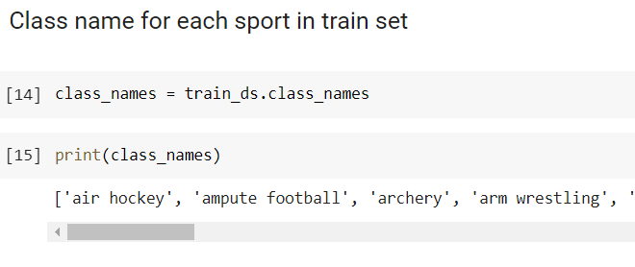
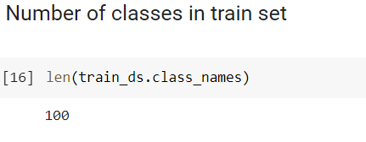
Create tf.data.Dataset
3.
4.

Slide 11
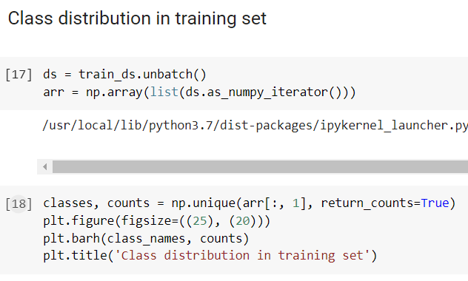
Class Distribution
Class distribution in training set
1.
Notes:
Here are the steps needed to display the class distribution for each dataset :
1. Each dataset is unbatched, which splits the elements of a dataset into multiple elements. The unbatched removes all the batches and it gives all samples one after another.
2. Then as_numpy_iterator returns an iterator that converts all elements of the dataset to numpy.
Then list() is used to form a list of all individual samples, from the list we form a numpy array.
3. Np.unique finds the unique elements of an array. After that the first column of the numpy array which contains the class name is used in Np.unique. The count is used in the second argument in Np.unique, which counts the number of images in each class.
Lastly, matplotlib.pyplot (plt) is used to plot the bar graph for each dataset as shown in (Figure 3.9 - Figure 3.14). Note that in Valid and Testing dataset classes have only 5 images.

Slide 12
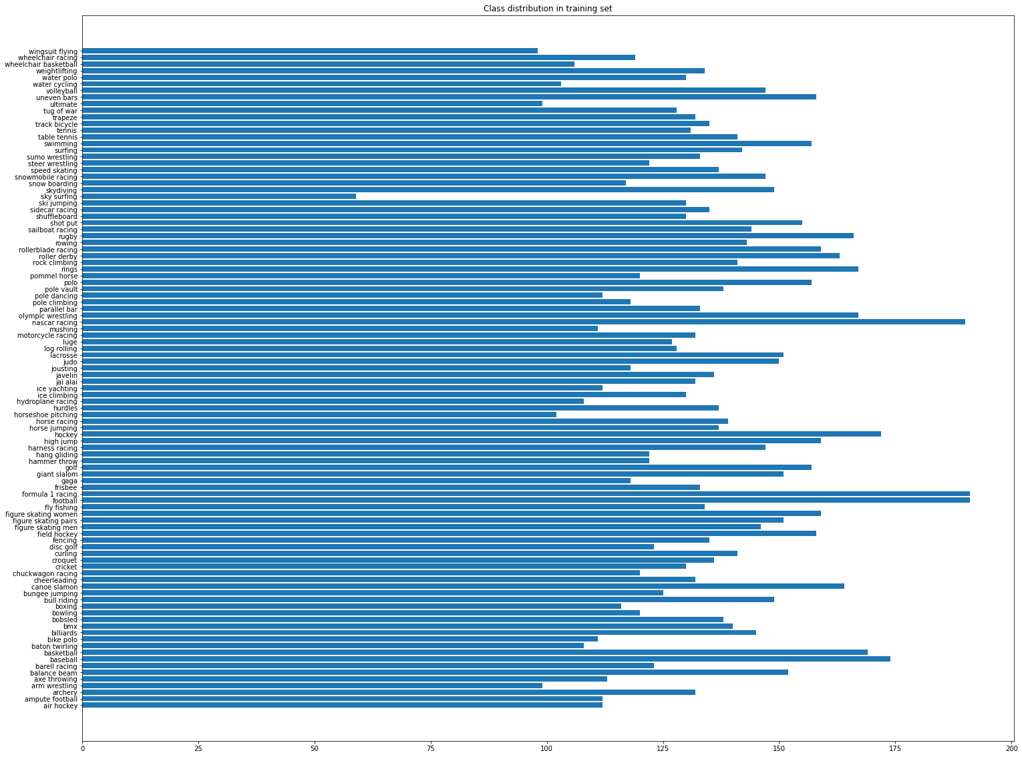
Class Distribution
Class distribution in training set
2.
Notes:
So, here it displays the numberof images in each class, the total images are 13752

Slide 13
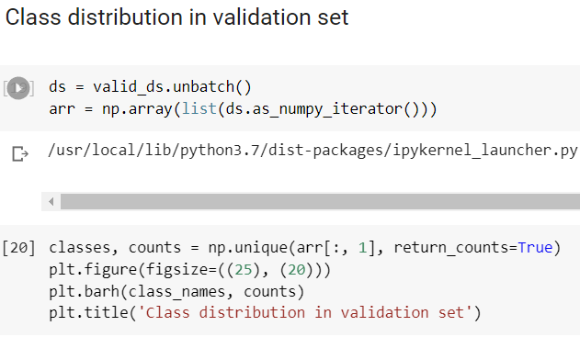
Class Distribution
Class distribution in validation set
1.

Slide 14
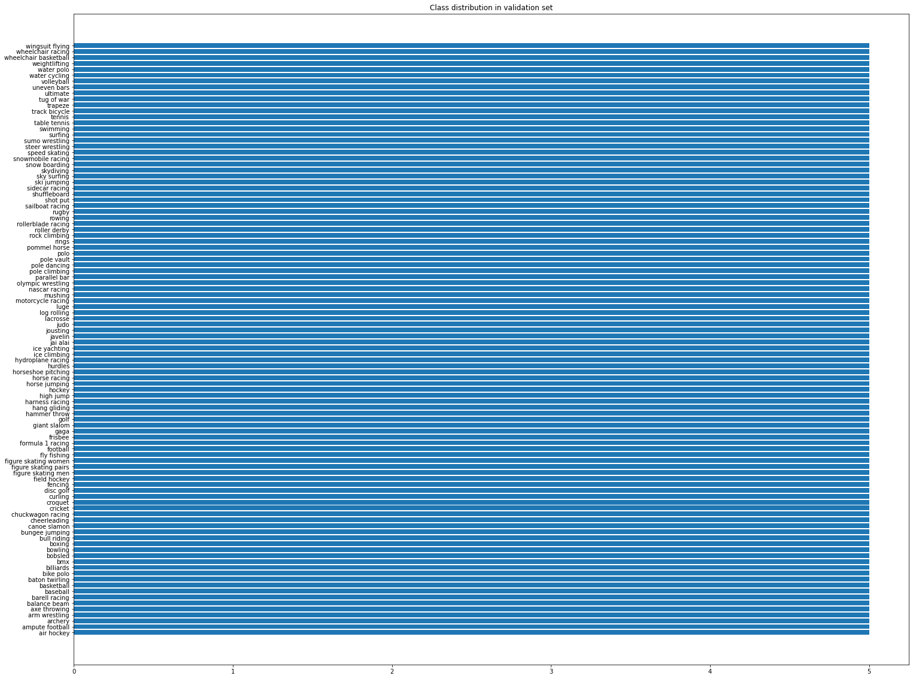
Class Distribution
Class distribution in validation set
2.

Slide 15
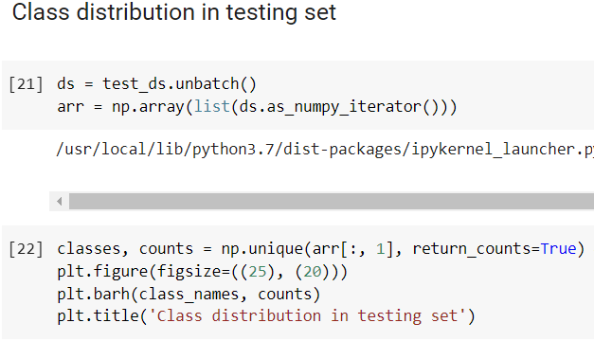
Class Distribution
Class distribution in testing set
1.

Slide 16

Class Distribution
Class distribution in testing set
2.

Slide 17
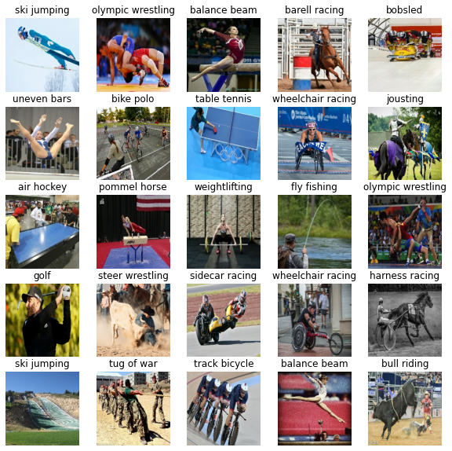
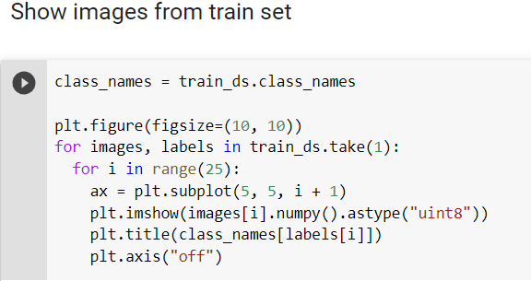
Displaying Images from the Datasets
Images from training dataset
1.
2.

Slide 18
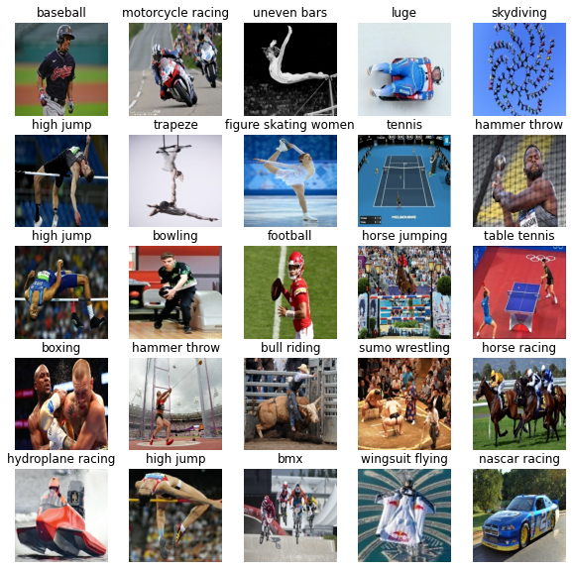
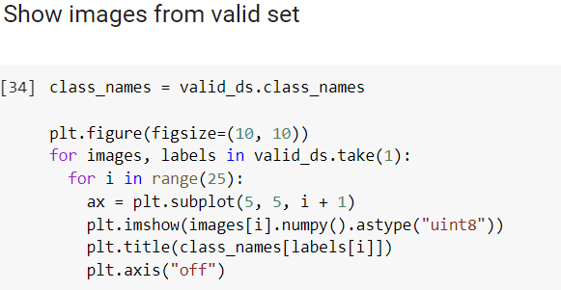
Displaying Images from the Datasets
Images from validation dataset
1.
2.

Slide 19
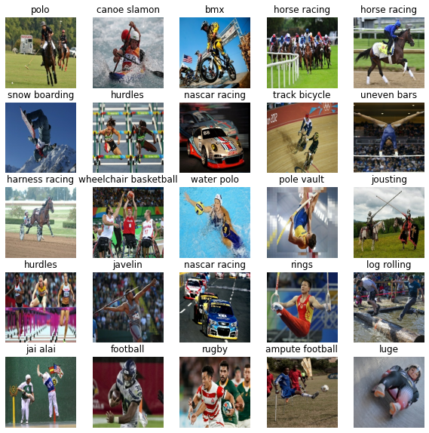
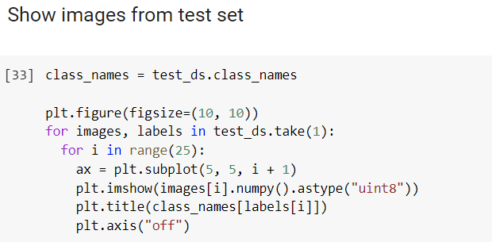
Displaying Images from the Datasets
Images from testing dataset
1.
2.

Slide 20
Research methodology and Models
Transfer Learning
MobileNetV2
VGG19
ResNet101V2
Convolutional Neural Network (CNN)
Comparison Between Models

Slide 21
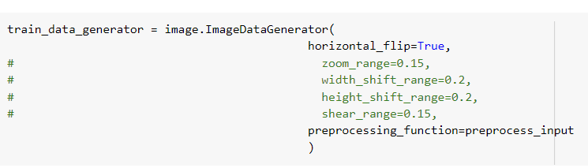
Transfer Learning
1.

Slide 22
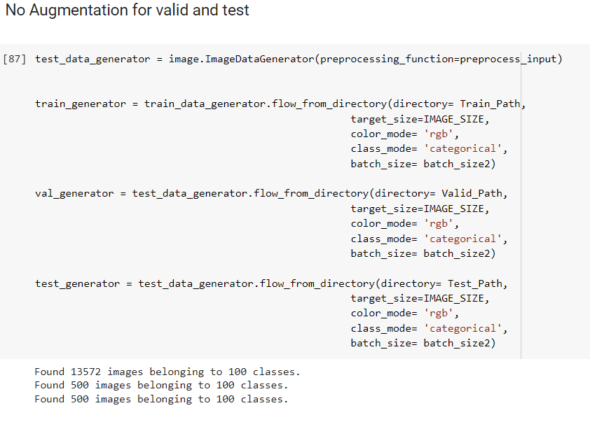
Transfer Learning
3.

Slide 23
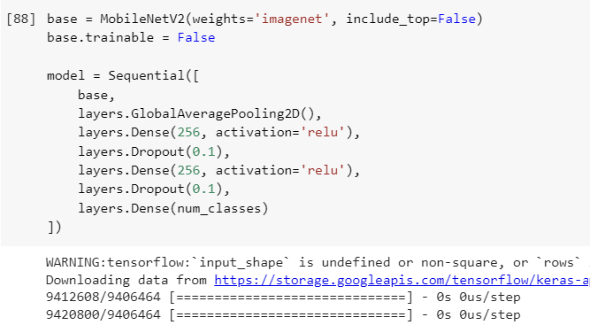
Transfer Learning
4.
Notes:
the base is set to be not trainable, so all children layers become non-trainable, as seen in (Figure 4.4).

Slide 24
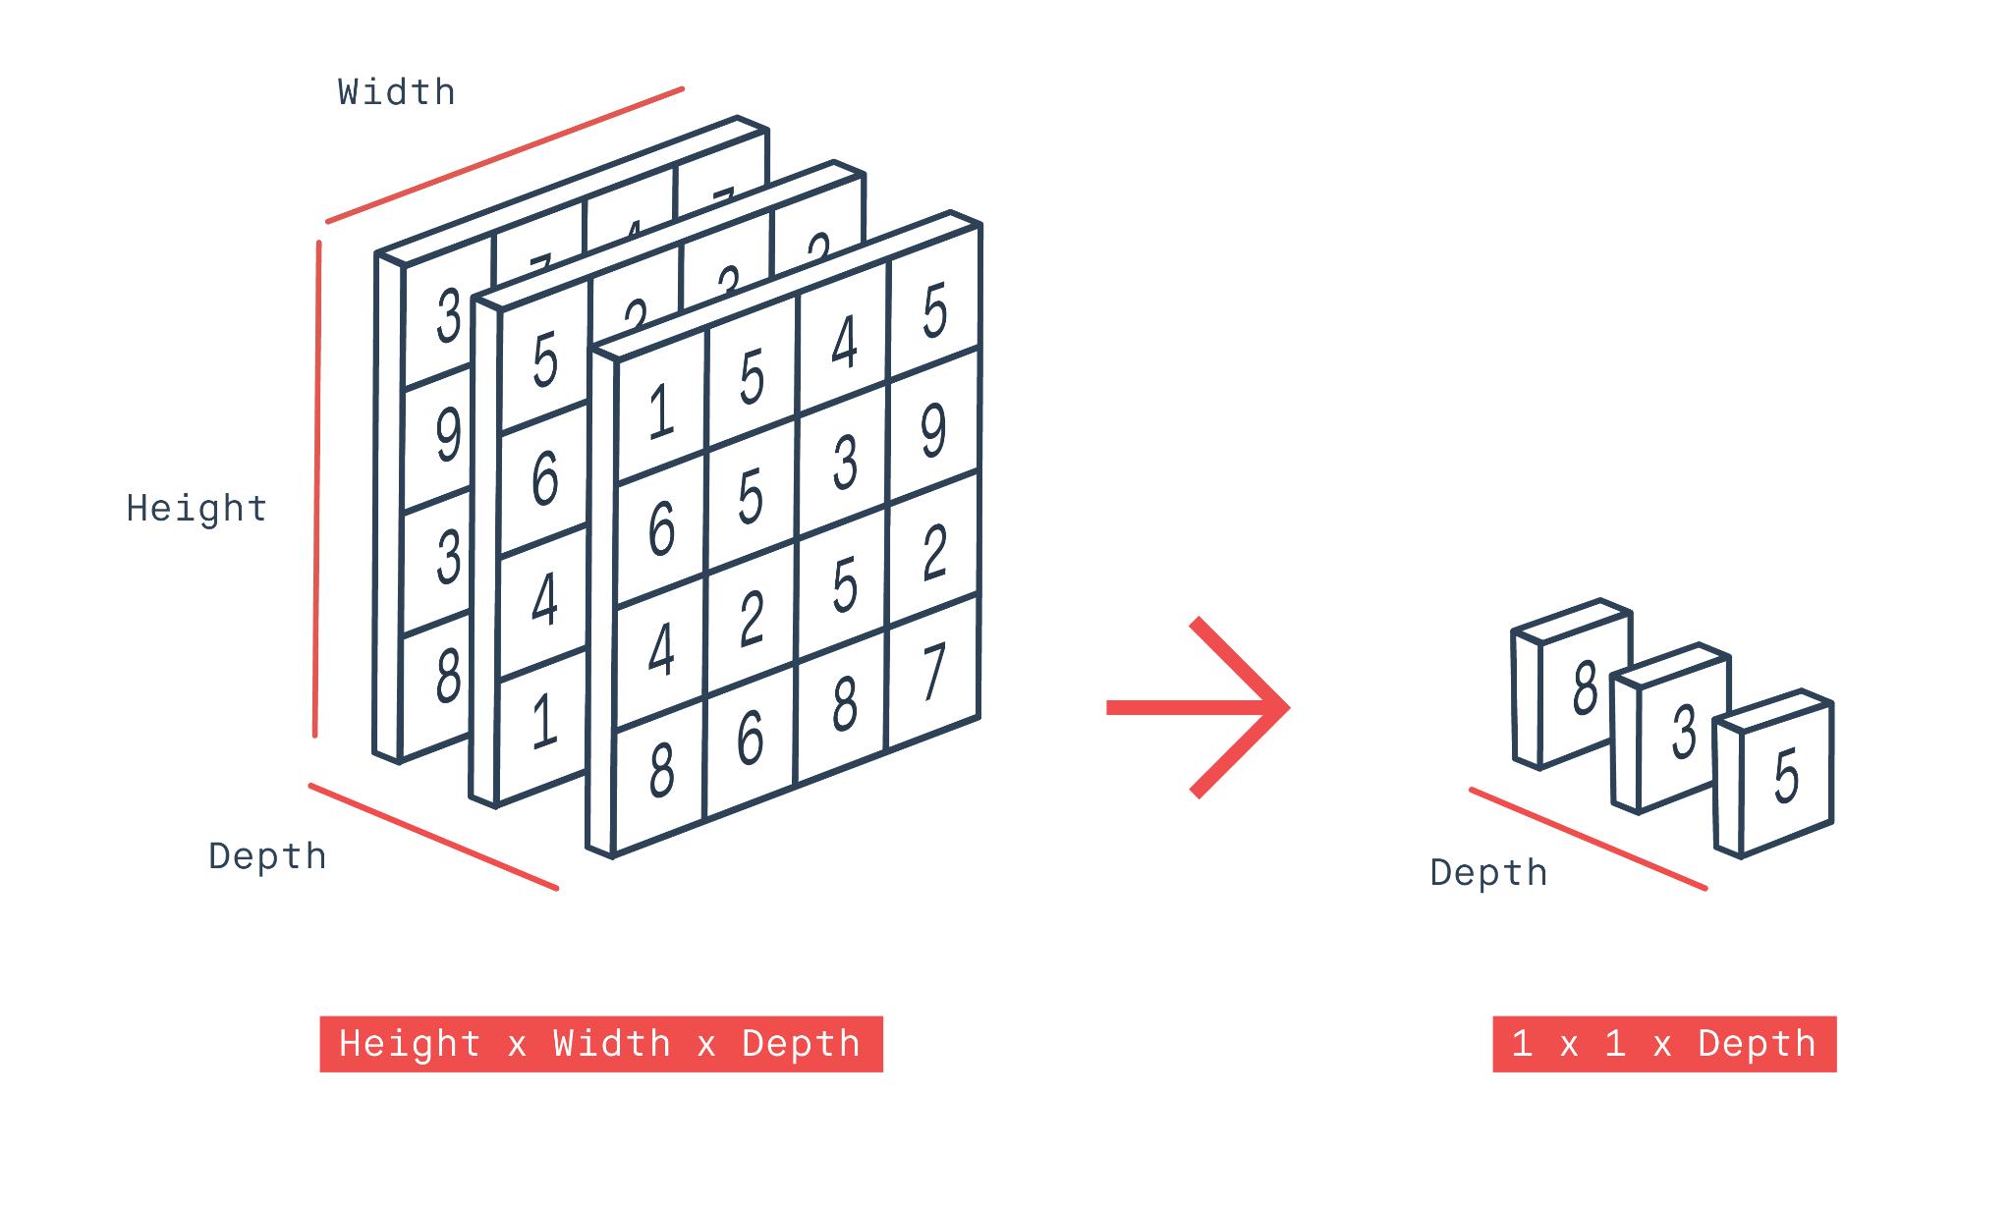
Transfer Learning
Global Average Pooling 2D Layer
Notes:
The global average pooling 2D layer takes a tensor of the size input width * input height * input channels and computes the average value of all values across the whole matrix for each 22 of the input channels. The first input channel sum is 80 divided by the matrix size (4*4), so the output is 5 as seen in (Figure 4.5 ).

Slide 25
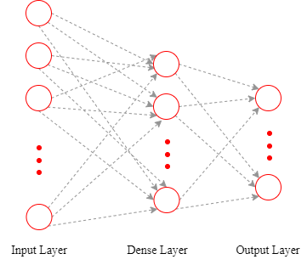
Transfer Learning
DenseLayer
Notes:
The dense layer is used to create fully connected layers, in which every output depends on every input as shown in (Figure 4.6).

Slide 26
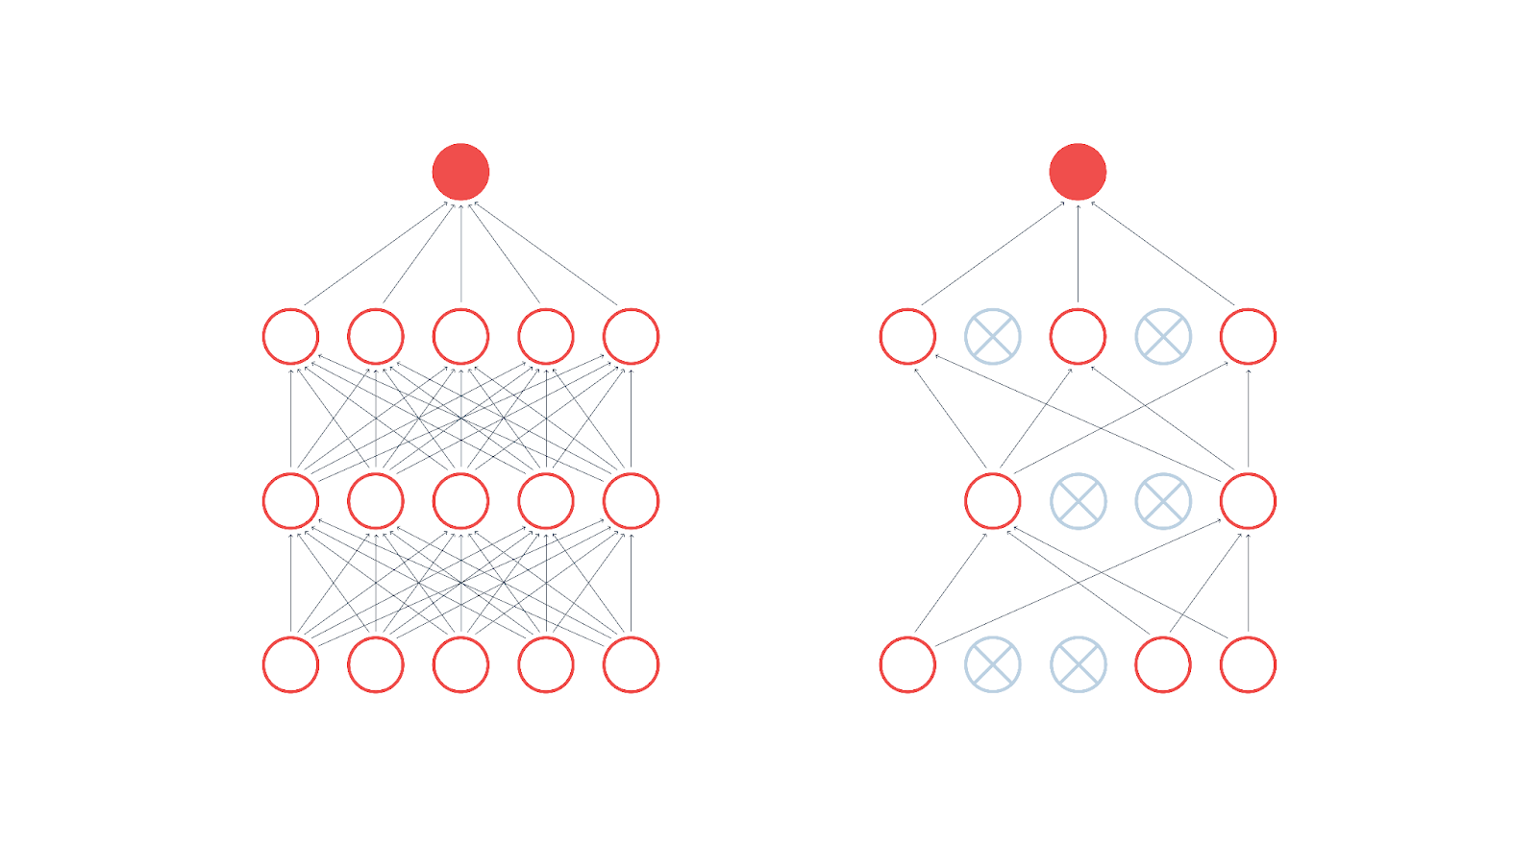
Transfer Learning
Dropout Layer
Notes:
The dropout layer randomly sets the outgoing edges of hidden units to 0 at each update of the training phase, which is used to prevent the possibility of overfitting as seen in (Figure 4.7).

Slide 27
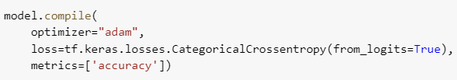
Transfer Learning
5.

Slide 28
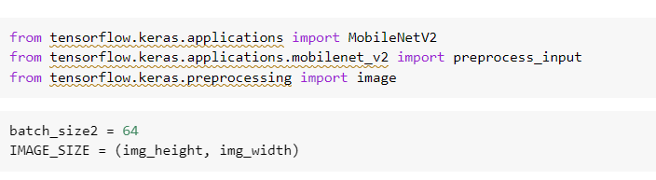
Transfer Learning : MobileNetV2
1.

Slide 29
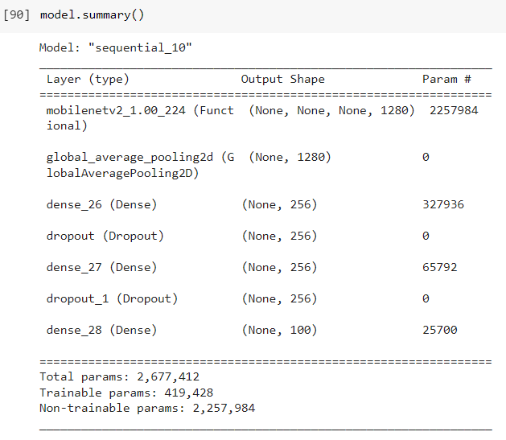
Transfer Learning : MobileNetV2
2.

Slide 30
Transfer Learning : MobileNetV2
Layer Calculations MobileNetV2
Layer Name | Layer Type | Number of parameters
mobilenetv2_1.00_224 | Functional | 2,257,984
global_average_pooling2d_3 | Global Average Pooling 2D | 0
dense_9 | Dense | 256(1280+1) = 327,936
dropout_6 | Dropout | 0
dense_10 | Dense | 256(256+1) = 65,792
dropout_7 | Dropout | 0
dense_11 | Dense | 100(256+1) = 25,700
Total | - | 2,677,412
Notes:
The total parameters after Global Average Pooling 2D Layer is 0 parameter because the layer does not learn anything, however it reduces the complexity of the model and to extract local features by finding the average values of each input channel as seen in (Figure 4.5).
To calculate the total parameters is to all parameters for each layer type. The total for non-trainable parameters is 2,257,984 parameters because the base is set to be not trainable, so all children layers become non-trainable, as seen in (Figure 4.4).
The number of trainable parameters is total parameters subtracted by non-trainable parameters (2,677,412 - 2,257,984) which equals 419,428.

Slide 31
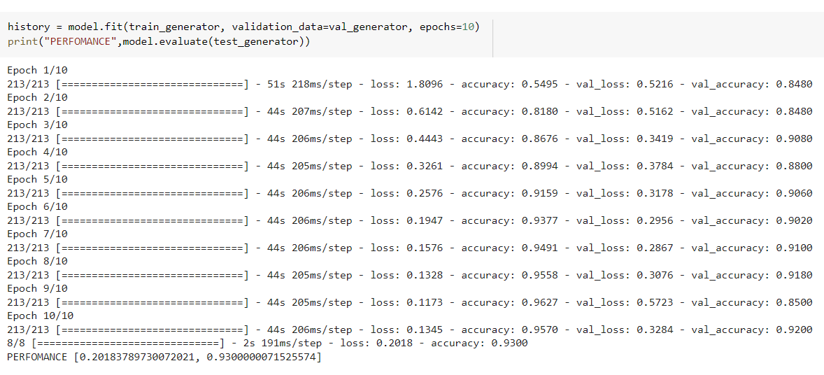
Transfer Learning : MobileNetV2
3.

Slide 32
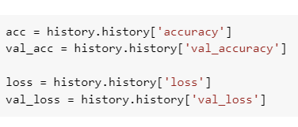
Transfer Learning : MobileNetV2
4.

Slide 33
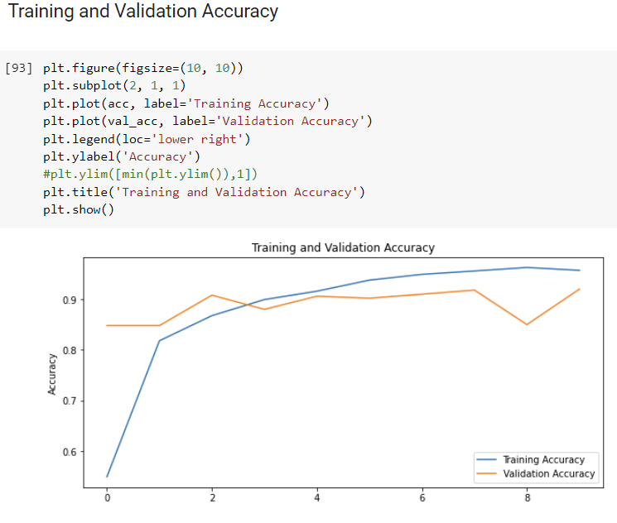
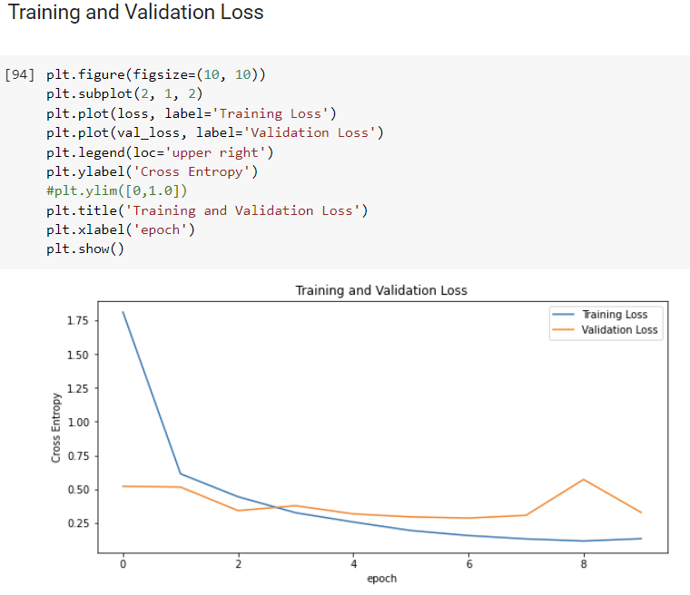
Transfer Learning : MobileNetV2
5.
Training and Validation Accuracy and Loss

Slide 34
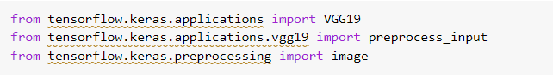
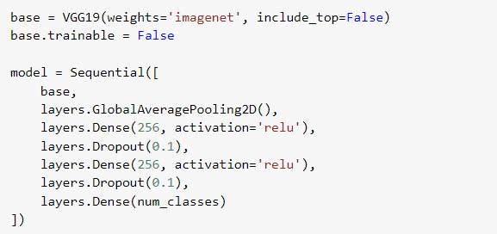
Transfer Learning : VGG19
1.
2.

Slide 35
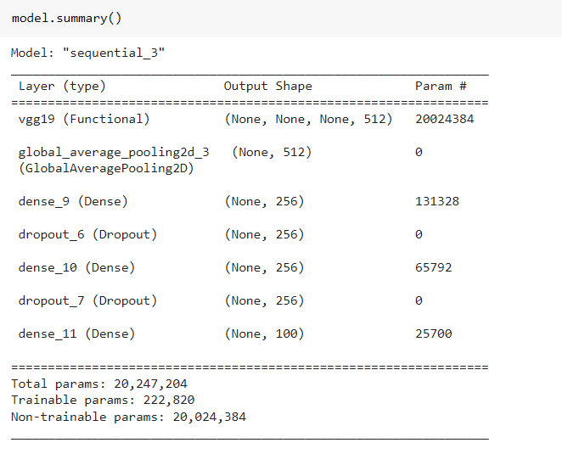
Transfer Learning : VGG19
3.

Slide 36
Transfer Learning : VGG19
Layer Calculations VGG19
Layer Name | Layer Type | Number of parameters
vgg19 | Functional | 20,024,384
global_average_pooling2d_3 | Global Average Pooling 2D | 0
dense_9 | Dense | 256(512+1) = 131,328
dropout_6 | Dropout | 0
dense_10 | Dense | 256(256+1) = 65,792
dropout_7 | Dropout | 0
dense_11 | Dense | 100(256+1) = 25,700
Total | - | 20,247,204

Slide 37
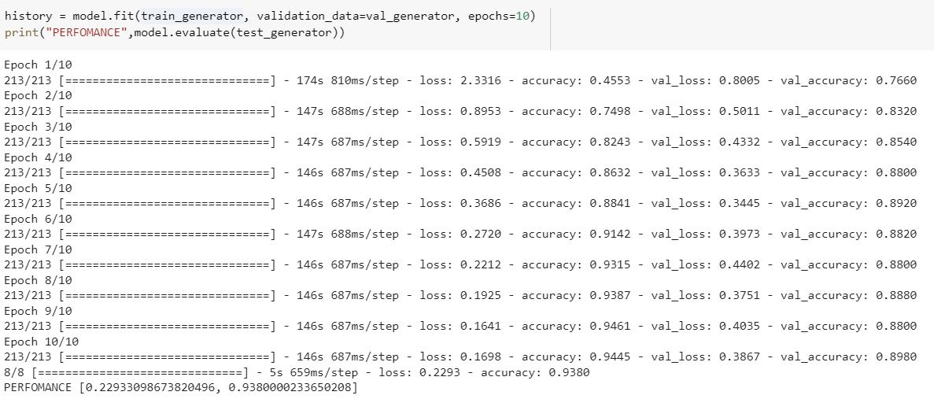
Transfer Learning : VGG19
4.

Slide 38
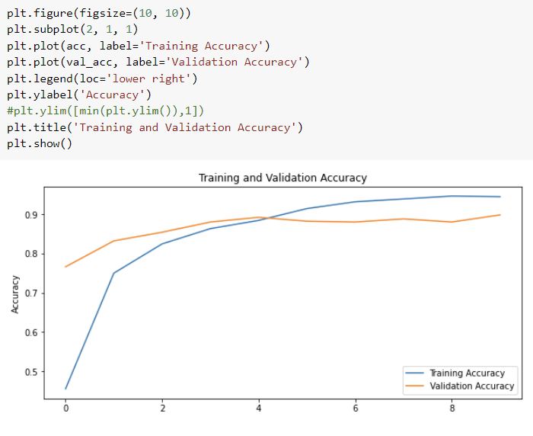
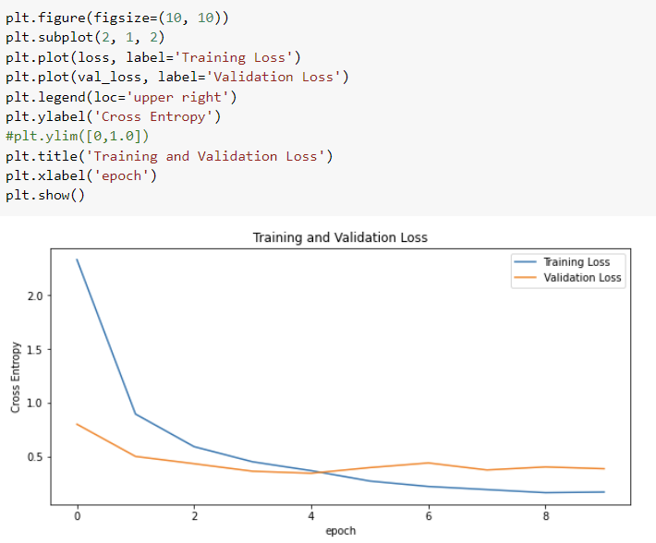
Transfer Learning : VGG19
5.
Training and Validation Accuracy and Loss

Slide 39
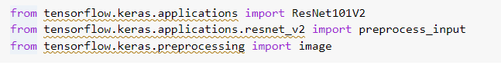
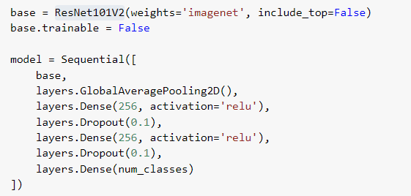
Transfer Learning : ResNet101V2
1.
2.

Slide 40
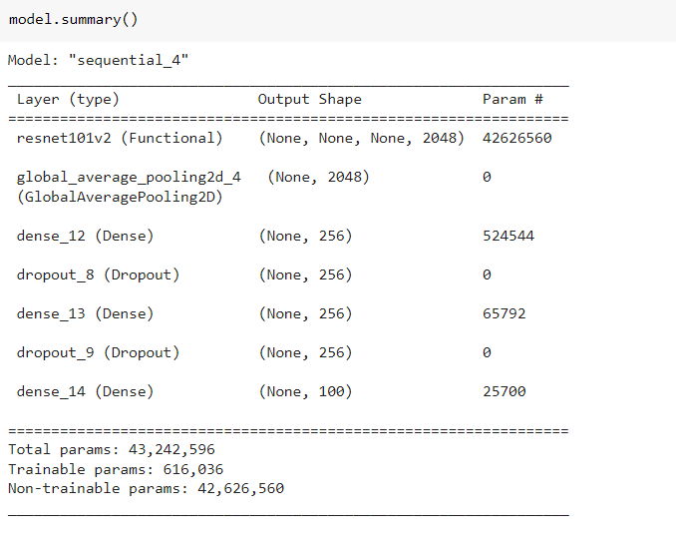
Transfer Learning : ResNet101V2
3.

Slide 41
Transfer Learning : ResNet101V2
Layer Calculations ResNet101V2
Layer Name | Layer Type | Number of parameters
resnet101v2 | Functional | 42,626,560
global_average_pooling2d_4 | Global Average Pooling 2D | 0
dense_12 | Dense | 256(2048+1) = 524,544
dropout_8 | Dropout | 0
dense_13 | Dense | 256(256+1) = 65,792
dropout_9 | Dropout | 0
dense_14 | Dense | 100(256+1) = 25,700
Total | - | 43,242,596

Slide 42
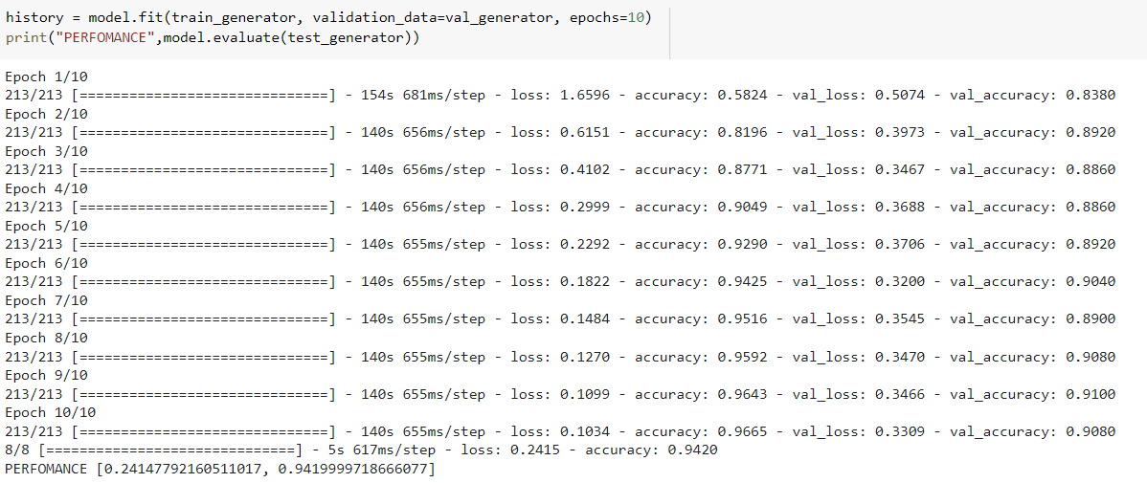
Transfer Learning : ResNet101V2
4.

Slide 43
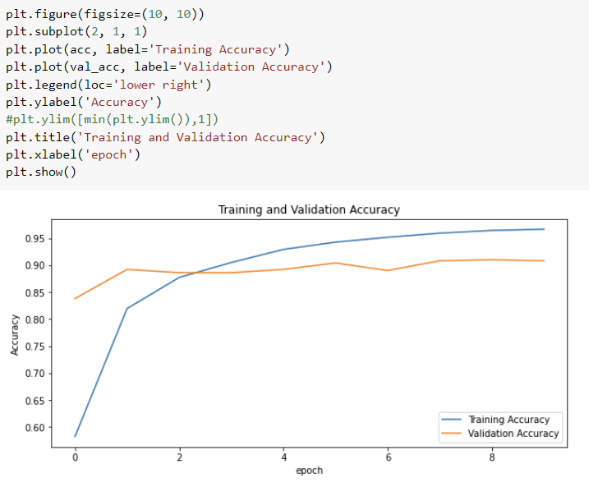
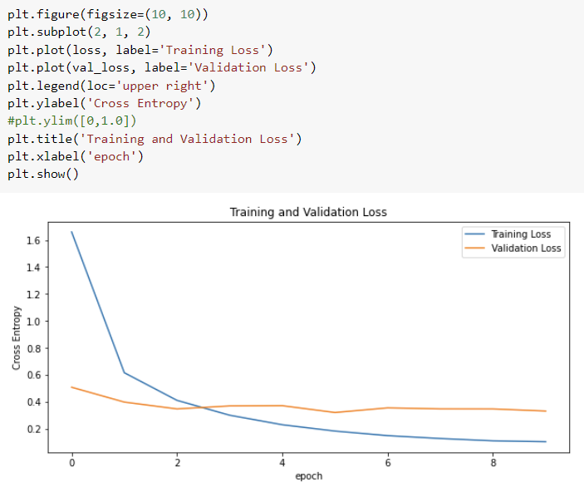
Transfer Learning : ResNet101V2
5.
Training and Validation Accuracy and Loss

Slide 44
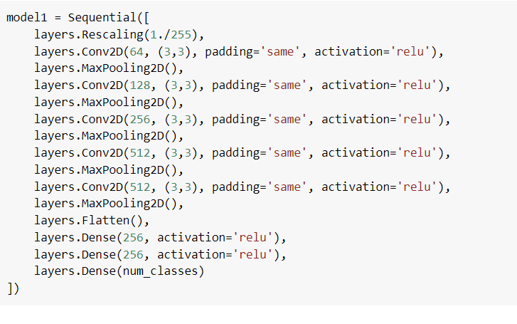
Convolutional Neural Network (CNN)
1.

Slide 45
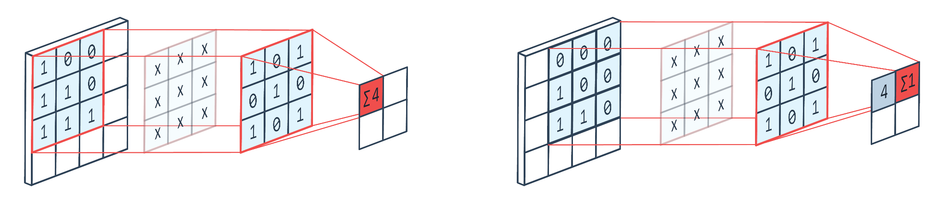
Convolutional Neural Network (CNN)
2D Convolution Layer
Notes:
The 2D convolution block is a layer which can be used to detect spatial features in an image, either working directly on the image data or on the output of previous convolution blocks.
Every block is consist of number of filters, where each filter is a height * width * channels matrix of trainable weights. As shown in (Figure 4.27), the filter channel is 3 * 3 ( height by width).

Slide 46
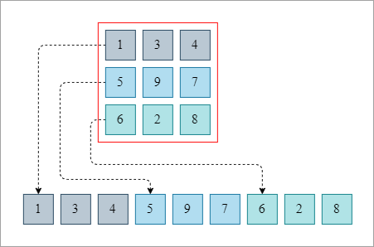
Convolutional Neural Network (CNN)
Flatten Layer
Notes:
Flatten the layer reshapes the tensor to have a shape that is equal to the number of elements contained in the tensor as illustrated in (Figure 4.28) .

Slide 47
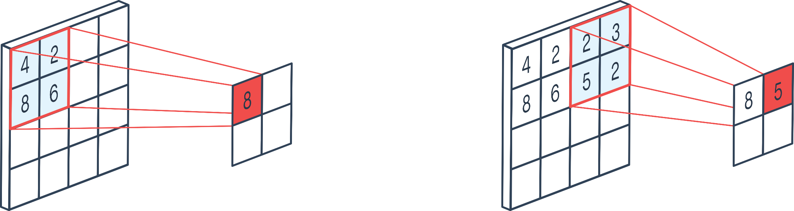
Convolutional Neural Network (CNN)
2D Max Pooling
Notes:
2D max pooling reduces the number of parameters, the size of data, the amount of computation needed, and it controls overfitting. As seen in (Figure 4.29), the max pooling block moves a rectangle over the incoming data, selecting the maximum in each certain window.

Slide 48
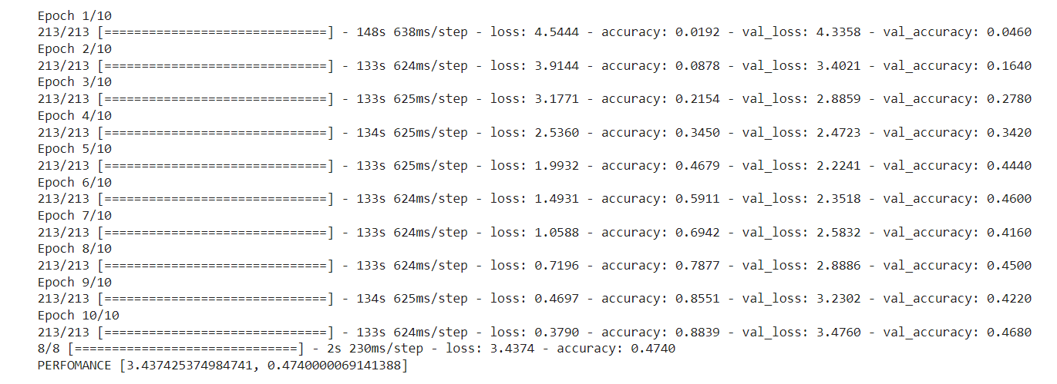
Convolutional Neural Network (CNN)
2.

Slide 49
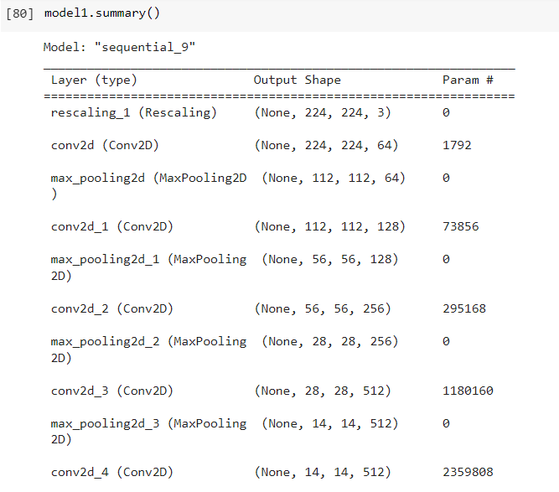
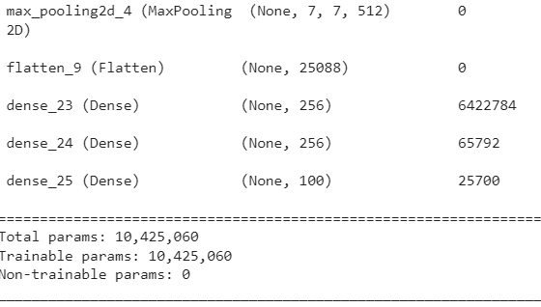
Convolutional Neural Network (CNN)
3.

Slide 50
Convolutional Neural Network (CNN)
Layer Calculations CNN
Layer Name | Layer Type | Number of parameters
rescaling_1 | Rescaling | 0
conv2d | Conv2D | 64 * ( 3 * 3 * 3 + 1) = 1792
max_pooling2d | Max Pooling 2D | 0
conv2d_1 | Conv2D | 128 * ( 64 * 3 * 3 + 1) = 73,856
max_pooling2d_1 | Max Pooling 2D | 0
conv2d_2 | Conv2D | 256 * ( 128 * 3 * 3 + 1) = 295,168
max_pooling2d_2 | Max Pooling 2D | 0
conv2d_3 | Conv2D | 512 * (256 * 3 * 3 + 1) = 1,180,160
max_pooling2d_3 | Max Pooling 2D | 0
Notes:
The rescalling layer parameter is zero because the layer does not learn anything, however it rescales and offsets the values of a batch of image, the rescaling is equal 1./255 as illustrated in (Figure 4.25) so the inputs are in the [0, 1] range.
To calculate the number of parameters in 2D convolution layer it needs the input channel number multiplied by kernel height multiplied by kernel width added by 1, lastly the final number of parameters multiplied by output channels number.

Slide 51
Convolutional Neural Network (CNN)
Layer Calculations CNN
conv2d_4 | Conv2D | 512 * ( 512 * 3 * 3 + 1) = 2,359,808
max_pooling2d_4 | Max Pooling 2D | 0
flatten_9 | Flatten | 0
dense_23 | Dense | 256 * (25088 + 1) = 6,422,784
dense_24 | Dense | 256 * (256 + 1) = 65,792
dense_25 | Dense | 100 ( 256 + 1) = 25,700
Total | - | 10,425,060

Slide 52


Convolutional Neural Network (CNN)
4.
Training and Validation Accuracy and Loss

Slide 53
Comparison Between Models
 | Transfer Learning
Architecture Model | MobileNetV2 | VGG19 | ResNet101V2
Accuracy (%) | 93.00 | 93.80 | 94.19
Loss (%) | 20.18 | 22.93 | 24.14
Number of Parameters | 2,257,984 | 20,024,384 | 42,626,560
 | Convolutional Neural Network (CNN)
Accuracy (%) | 47.40
Loss (%) | 343.7

Slide 54
Initialization, Training, and Tuning of Hyperparameters
Transfer Learning
MobileNetV2
VGG19
ResNet101V2
Convolutional Neural Network (CNN)

Slide 55
Transfer Learning : MobileNetV2
Batch Number | Number of Epochs | Image Size | Optimizer | Testing Results
 |  |  |  | Accuracy (%) | Loss (%)
64 | 10 | (224,224) | Adam | 93.00 | 20.18
128 | 10 | (224,224) | Adam | 93.99 | 18.99
64 | 10 | (224,224) | RMSprop | 82.59 | 55.29
128 | 10 | (224,224) | RMSprop | 93.80 | 23.26

Slide 56


Transfer Learning : MobileNetV2

Slide 57
Transfer Learning : VGG19
Batch Number | Number of Epochs | Image Size | Optimizer | Testing Results
 |  |  |  | Accuracy (%) | Loss (%)
64 | 10 | (224,224) | Adam | 93.80 | 22.93
128 | 10 | (224,224) | Adam | 92.40 | 30.08
64 | 10 | (224,224) | RMSprop | 92.19 | 36.90
128 | 10 | (224,224) | RMSprop | 92.19 | 25.80

Slide 58


Transfer Learning : VGG19

Slide 59
Transfer Learning : ResNet101V2
Batch Number | Number of Epochs | Image Size | Optimizer | Testing Results
 |  |  |  | Accuracy (%) | Loss (%)
64 | 10 | (224,224) | Adam | 94.19 | 24.14
128 | 10 | (224,224) | Adam | 92.79 | 21.37
64 | 10 | (224,224) | RMSprop | 93.59 | 30.00
128 | 10 | (224,224) | RMSprop | 91.60 | 28.04

Slide 60


Transfer Learning : ResNet101V2

Slide 61
Convolutional Neural Network (CNN)
Batch Number | Number of Epochs | Image Size | Optimizer | Testing Results
 |  |  |  | Accuracy (%) | Loss (%)
64 | 10 | (224,224) | Adam | 47.40 | 343.7
128 | 10 | (224,224) | Adam | 47.40 | 287.1
64 | 10 | (224,224) | RMSprop | 51.59 | 358.33
128 | 10 | (224,224) | RMSprop | 46.79 | 437.5

Slide 62


Convolutional Neural Network (CNN)

Slide 63
Performance evaluation, comparison, and discussion on the results
Comparison of the Machine Learning Models
Comparison on the results of other researchers
Results comparison with Pavan kalyan
Results comparison with Prashant Brahmbhatt
Results comparison with Hamza Manssor

Slide 64

Comparison of the Machine Learning Models : Transfer Learning

Slide 65

Comparison of the Machine Learning Models : Transfer Learning

Slide 66

Comparison of the Machine Learning Models : CNN

Slide 67
Comparing transfer learning and convolutional neural networks

Slide 68

Comparison on the results of other researchers : Pavan kalyan

Slide 69

Comparison on the results of other researchers : Prashant Brahmbhatt

Slide 70

Comparison on the results of other researchers : Prashant Brahmbhatt

Slide 71

Comparison on the results of other researchers : Hamza Manssor

Slide 72
Conclusion and Future Enhancements

Slide 73
Thank You

